Slide 1
Preprints and publishing
Conference: 21 August 2022
Pippa Smart
PSP Consulting
EiC, Learned Publishing
Pippa.smart@gmail.com
editor@alpsp.org
www.pspconsulting.org
http://learned-publishing.org
Notes:
Puebla, I., Polka, J., & Rieger, O. (2021, February 18). Preprints: Their Evolving Role in Science Communication.MetaArxiv Preprints. https://doi.org/10.31222/osf.io/ezfsk

Slide 2
Talk outline
How preprints have changed article workflow
A brief history of preprint servers
Journals and preprints
Benefits and disadvantages
The future?

Slide 3
The changing workflow
EARLY DRAFTS
Journal submission system
Journal website
Editing typesetting etc.
Submitted version
Accepted version
Version of record
Peer review
Revised version

Slide 4
Journal submission system
Editing typesetting etc.
Journal website
EARLY DRAFTS
Submitted version
Accepted version
Version of record
Peer review
Revised version
Link
Early version
Preprint server
Notes:
Early version may be updated before submission (comments)

Slide 5
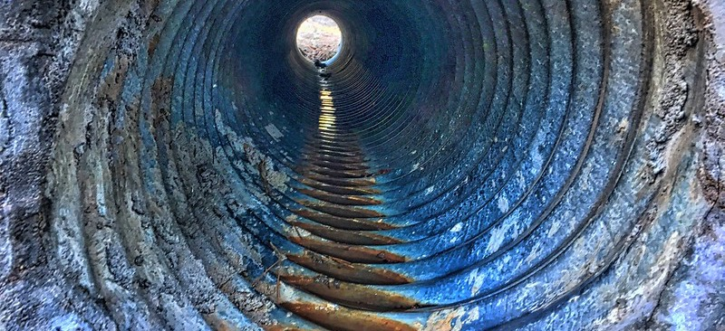
Preprint history
Notes:
Useful ref - https://publons.com/blog/the-what-why-and-how-of-preprints-and-peer-review/

Slide 6
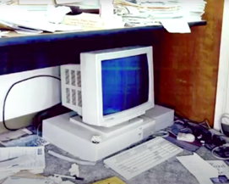
The original?
ArXiv
Launched 1991, Los Alamos National Laboratory, USA, by Paul Ginsparg
Now managed out of Cornell
Launched as xxx.lanl.gov, renamed as ArXiv.org in 1998
1.8m articles
16,000 submissions per month
The original server, on Paul Ginsparg’s desk
Notes:
Photo from https://www.youtube.com/watch?v=1w7lQtcoYoo
Paul Ginsparg (2011) It was twenty years ago today ... ArXiv.org preprint [Submitted on 14 Aug 2011 (v1), last revised 13 Sep 2011 (this version, v2)] arXiv:1108.2700
https://blog.arxiv.org/2021/02/08/2020-annual-report-now-available/
launched to facilitate easy, quick, sharing of research - taking advantage of the new world wide web.
fairly rapid growth, but notable growth in past 20 years as internet took hold
The inaugural Einstein Foundation Berlin Award for Promoting Quality in Research by the Einstein Foundation has been awarded to Paul Ginsparg, November 2021

Slide 7
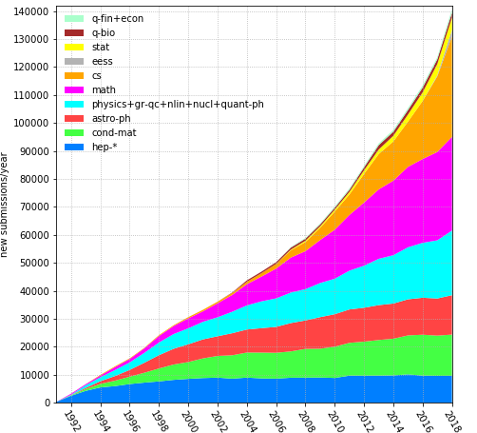
ArXiv.org: changing topics
Notes:
https://arxiv.org/help/stats/2018_by_area
8 subject categories
Submissions
Predominantly High Energy Physics at the start
now mostly maths articles
Math articles – 22%

Slide 8
ArXiv deposit and citation
Effect on journals?
Higher citations to version of record?
Duplicated citations
Photo: Caren Florence, Paper piled: Flikr
Notes:
Some evidence of higher citation to final journal article
One report showed 35% increase in citation of the journal article
But fewer downloads from the publisher site - implications for the usefulness of the journal? also metrics associated with the DOI version of record?
Increased citations and h-index?
Two articles: preprint and version of record

Slide 9
A close follower: SSRN
(Social Science Research Network)
Launched 1994
By 2013 was the largest repository!
2016 purchased by Elsevier
Over 1.1m articles
Ranks articles using downloads, citations and number of authors
Notes:
Launch
Growth
Purchase by Elsevier (and ensuing problems)
https://en.wikipedia.org/wiki/Social_Science_Research_Network
https://hq.ssrn.com/rankings/ranking_data_explain.cfm?id=10
launched by Michael Jensen and Wayne Marr, both financial economists.^{[2]}
In January 2013, SSRN was ranked the biggest open-access repository in the world by Ranking Web of Repositories (an initiative of the Cybermetrics Lab, a research group belonging to the Spanish National Research Council),^{[3]} measured by number of PDF files, backlinks and Google Scholar results.^{[4]}
In May 2016, SSRN was bought from Social Science Electronic Publishing Inc. by Elsevier.^{[1]}

Slide 10
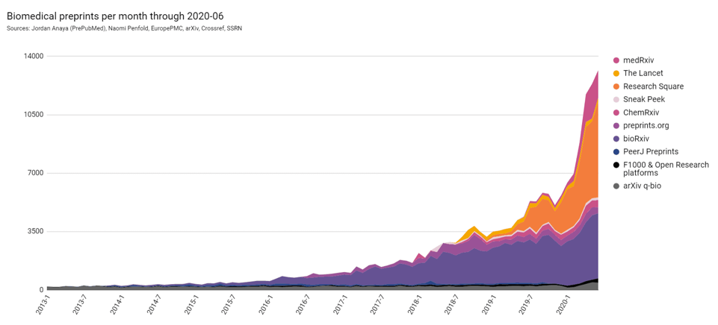
Recent growth
Launch of MedRxiv
Launch of BioRxiv
Source, ASAPbio, 2022
Notes:
https://asapbio.org/preprint-info/biology-preprints-over-time

Slide 11
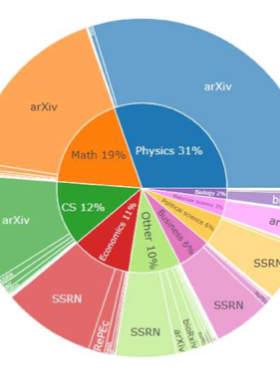
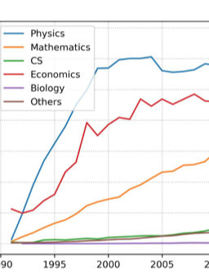
30 years …
Preprints = c.4% published articles
C.60% are not published in a journal
(or 75%?)
Skew of disciplines
Is preprint the future of science? A thirty year journey of online preprint services
Boya Xie, Zhihong Shen, Kuansan Wang. ArXiv, 2021
Notes:
https://arxiv.org/abs/2102.09066
Is preprint the future of science? A thirty year journey of online preprint services
Boya Xie, Zhihong Shen, Kuansan Wang

Slide 12
Preprints and journals 6 steps to acceptance?

Slide 13
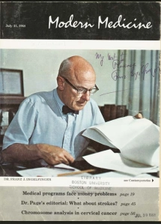
Preprints and journals: 1 – uneasy relationship
Ingelfinger rule
Still in operation?
Notes:
Uneasy relationship
Ingelfinger rule – now irrelevant? The rule is named for Franz J. Ingelfinger, the NEJM editor-in-chief who enunciated it in 1969
Acceptance
Encouragement
Incorporation (1) Overlay journals, (2) F1000Research
in 2013 “More than half of US neuroscientists and more than 60% of German neuroscientists perceive the so-called Ingelfinger rule (42) as still effective. According to that rule, “acceptance of a publication by a scientific journal [is] threatened if the research results have already been reported in the mass media” (Table 1). ”
https://embargowatch.wordpress.com/2013/08/22/scientists-like-the-gag-order-of-the-ingelfinger-rule-says-new-paper/
https://scholarlykitchen.sspnet.org/2018/05/21/journals-lose-citations-preprint-servers-repositories/
background article - https://sr.ithaka.org/publications/preprints-in-the-spotlight/#post-313288-footnote-12

Slide 14
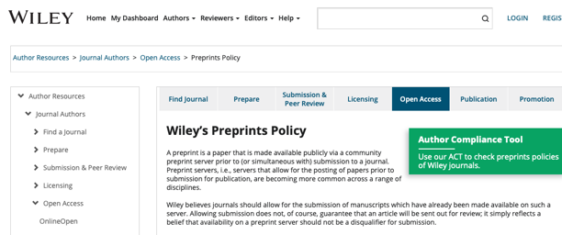
Preprints and journals: 2- acceptance
Wiley believes journals should allow for the submission of manuscripts which have already been made available ….
Notes:
https://authorservices.wiley.com/author-resources/Journal-Authors/open-access/preprints-policy.html
https://www.springer.com/gp/open-access/preprint-sharing/16718886

Slide 15
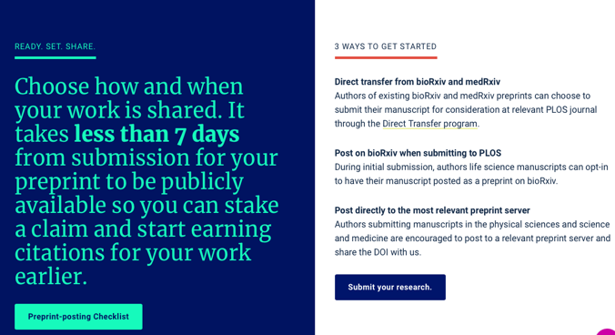
Preprints and journals: 3- encouragement
Notes:
PLOS journals, as an example will deposit articles into bioRxiv/MedRxiv on behalf of authors on submission (if they are not already on bioRxiv)

Slide 16
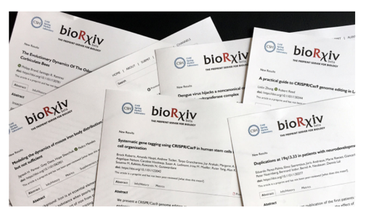
Preprints and journals: 4- participation
Notes:
Some are even closer - the Lancet will automatically deposit all submissions onto SSRN (owned by its parent, Elsevier) unless the authors specifically request it not to be posted
eLife has announced that from June 2021 it will only accept articles that have already been posted on bio/med

Slide 17
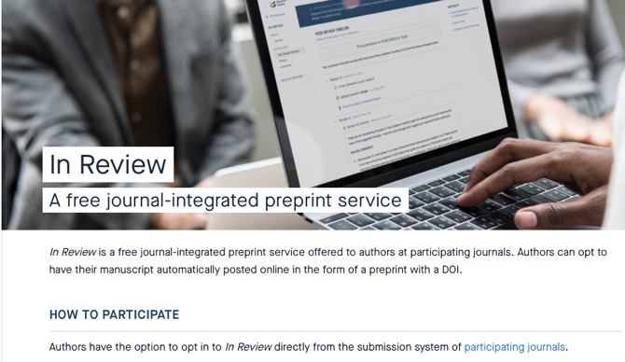
Preprints and journals: 4- participation
Notes:
Research Square preprint server integrated with journals using

Slide 18
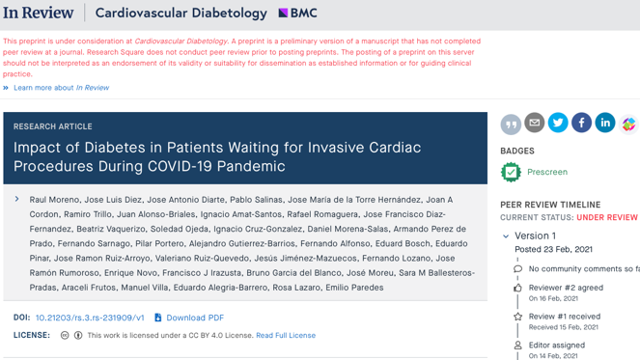
Notes:
of every submitted article onto eLife - even those it rejects

Slide 19
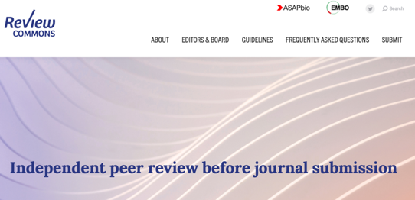
Preprints and journals: 5- Reviewing service?
Notes:
https://www.embo.org/news/press-releases/2019/embo-and-asapbio-to-launch-a-pre-journal-portable-review-platform.html
partnership is the next step and a very interesting initiative from the publisher EMBO and the initiative ASAPbio is to review articles posted on bio/med - reviews are posted onto the preprint server. The authors can then revise their article and submit to a journal - there are 7 participating journals that will accept the reviews (other journals may accept them or not)
eLife also started to provide the same service (note there is no charge for this reviewing service) and recently made the announcement that it will be posting reviews of every submitted article onto eLife - even those it rejects

Slide 20
Preprints and journals: 6- merger …
Notes:
The next logical step is merger of the journal and preprint model, and this has been done by F1000R. <explain how it works>
also adopted by Welcome Open and several other funders (including the by EU Horizon funding programme)

Slide 21
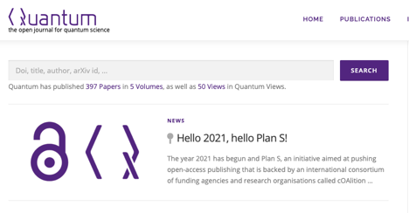
Preprints and journals: 6- … and overlay
Notes:
https://blog.scholasticahq.com/post/journals-using-overlay-publishing-models-equitable-oa/
Another model which merges preprints and journals is the overlay journal model. <explain how this works>
this effectively converts journals into an accreditation service - identifying articles (preprints) that are considered good or high quality.

Slide 22
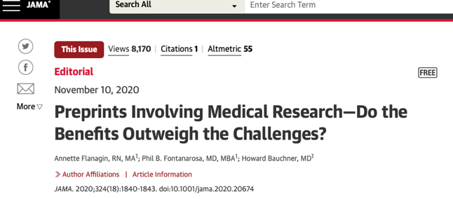
2020: Watershed?
NEJM accepts the submission of manuscripts that have previously been posted on a nonprofit preprint server.
Notes:
worth mentioning that 2020 was a watershed year with a massive growth in biomedical preprints and this has overcome resistance to them in most journals
and what about the NEWJM - have they overturned the Ingelfinger rule? Yes

Slide 23
Preprint advantage?
Notes:
Chiarelli A, Johnson R, Pinfield S and Richens E. Preprints and Scholarly Communication: An Exploratory Qualitative Study of Adoption, Practices, Drivers and Barriers [version 2; peer review: 3 approved, 1 approved with reservations]. F1000Research 2019, 8:971 (https://doi.org/10.12688/f1000research.19619.2)

Slide 24
Preprint advantage
Fast circulation
Priority publication
Democratic
Open science
Increased visibility
Versions available
Control
Community feedback
Notes:
Chiarelli A, Johnson R, Pinfield S and Richens E. Preprints and Scholarly Communication: An Exploratory Qualitative Study of Adoption, Practices, Drivers and Barriers [version 2; peer review: 3 approved, 1 approved with reservations]. F1000Research 2019, 8:971 (https://doi.org/10.12688/f1000research.19619.2)

Slide 25
Problems with preprints
Notes:
Chiarelli A, Johnson R, Pinfield S and Richens E. Preprints and Scholarly Communication: An Exploratory Qualitative Study of Adoption, Practices, Drivers and Barriers [version 2; peer review: 3 approved, 1 approved with reservations]. F1000Research 2019, 8:971 (https://doi.org/10.12688/f1000research.19619.2)

Slide 26
Problems with preprints
Quality assurance (peer review)
Version control
Information overload
Political influence?
Citation dilution
Promotion of bad science
Reputation damage for authors
Inflation of results
?
Corrections
Notes:
Chiarelli A, Johnson R, Pinfield S and Richens E. Preprints and Scholarly Communication: An Exploratory Qualitative Study of Adoption, Practices, Drivers and Barriers [version 2; peer review: 3 approved, 1 approved with reservations]. F1000Research 2019, 8:971 (https://doi.org/10.12688/f1000research.19619.2)

Slide 27
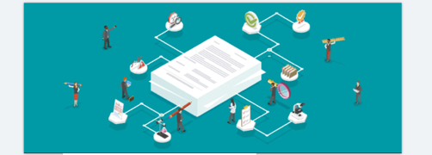
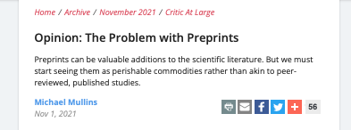
Problems with preprints
Notes:
Chiarelli A, Johnson R, Pinfield S and Richens E. Preprints and Scholarly Communication: An Exploratory Qualitative Study of Adoption, Practices, Drivers and Barriers [version 2; peer review: 3 approved, 1 approved with reservations]. F1000Research 2019, 8:971 (https://doi.org/10.12688/f1000research.19619.2)

Slide 28
Challenges for preprints, journals and editors
Journal policy?
Citation?
Retraction?
Author confusion?
Do we need journals?
Correction?
Notes:
Chiarelli A, Johnson R, Pinfield S and Richens E. Preprints and Scholarly Communication: An Exploratory Qualitative Study of Adoption, Practices, Drivers and Barriers [version 2; peer review: 3 approved, 1 approved with reservations]. F1000Research 2019, 8:971 (https://doi.org/10.12688/f1000research.19619.2)

Slide 29
The future impact of preprints?

Slide 30
Resources
ASAPbio - https://asapbio.org
BioRxiv - https://www.biorxiv.org
SherpaRomeo database of journal policies - https://v2.sherpa.ac.uk/romeo/about.html
NISO, preprint trends - https://www.niso.org/niso-io/2019/11/evolving-role-preprints-open-access-publishing-landscape
Higgins, J. and Steiner, R.D. (2021), Author preprint behaviour and non-compliance with journal preprint policies: One biomedical journal's experience. Learned Publishing, 34: 389-395. https://doi.org/10.1002/leap.1376
Urbano, C., Tafalla, S., Borrego, Á. and Abadal, E. (2021), Preprints as an alternative to conference proceedings: A hands-on experience at EDICIC Iberian Meeting 2019. Learned Publishing, 34: 558-567. https://doi.org/10.1002/leap.1402
Hurst, P. and Greaves, S. (2021), COVID-19 Rapid Review cross-publisher initiative: What we have learned and what we are going to do next. Learned Publishing, 34: 450-453. https://doi.org/10.1002/leap.1375
Cooper AN, Dwyer JE (2021) Maintaining the integrity of the scientific record: corrections and best practices at The Lancet group. European Science Editing 47: e62065. https://doi.org/10.3897/ese.2021.e62065

Slide 31
Thank you for listening
Pippa Smart
PSP Consulting
EiC, Learned Publishing
Pippa.smart@gmail.com
editor@alpsp.org
www.pspconsulting.org
http://learned-publishing.org

